Slide 1
GRAPH ALGORITHMS
Submitted by:
Name: SHAGUN
Roll : 181210049
Batch: CSE 2nd year

Slide 2
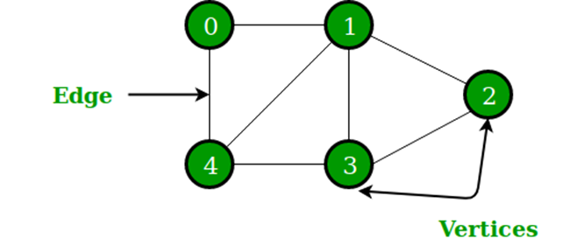
Graph Algorithms
Graph is a non linear data structure that consists of a set of nodes (vertices) and a set of edges that relate the nodes to each other.
●The set of edges describes relationships among the vertices .
●A graph G is defined as follows: G = (V, E)
ØV(G): a finite, nonempty set of vertices
ØE(G): a set of edges (pairs of vertices)

Slide 3
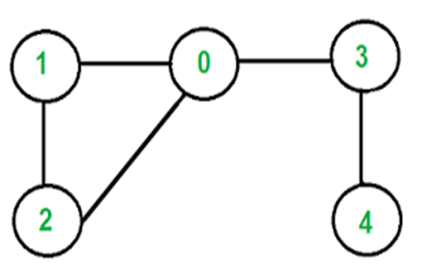
Example:
● V = {0, 1, 2, 3, 4}
● E = { (0, 1) , (1, 2) , (0, 3) , (0, 2) , (4, 3) }

Slide 4
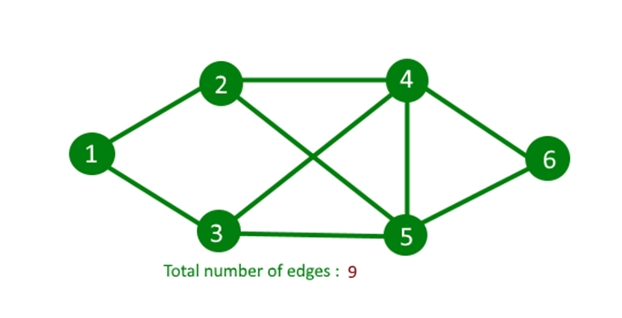
Types of Graph:
1. Undirected Graphs
An undirected graph is a graph that has no orientation. That is the edge (x, y) is identical to (y, x) i.e. they are not ordered pairs. The maximum number of edges possible in an undirected graphs are n*(n-1)/2 and the minimum number of edges in an undirected graphs are (n-1).

Slide 5
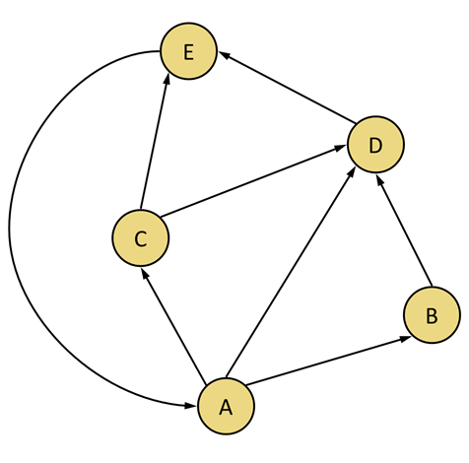
2. Directed Graphs
A graph with orientations. The edge pair (x, y) is not the same as (y, x) i.e. it is an ordered pair. The maximum number of edges in a directed graph is n*(n-1), (twice the number in undirected graphs).

Slide 6
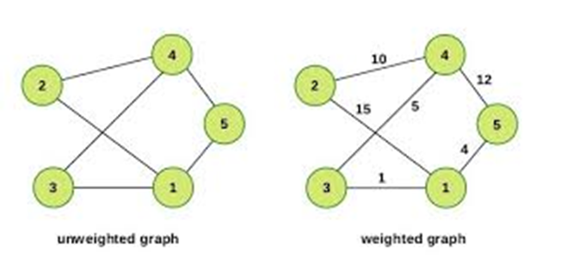
3. Weighted & Unweighted graphs
A weighted graph associates a value (weight) with every edge in the graph. Words, cost or length can also be used instead of weights.And, an unweighted graph does not associate any value (weight) with any edge of the graph.

Slide 7
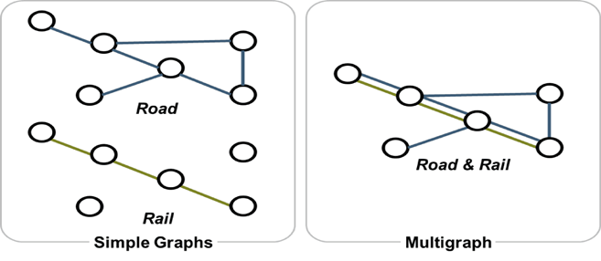
4. Multigraph & Simple Graph
A multigraph is an undirected graph in which multiple edges are allowed (sometimes) loops. Multiple edges refer to two or more edges that connect the same vertices. A simple graph as opposed to a multigraph, is an undirected graph in which both multiple edges and loops are disallowed.

Slide 8
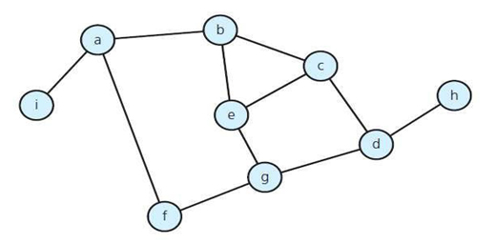
Number of edges - Undirected Graph
The no. of possible pairs of vertices in an n vertex graph is n*(n-1).
Since edge (u, v) is the same as edge (v, u), the number of edges in an undirected graph is <= n*(n- 1)/2.

Slide 9
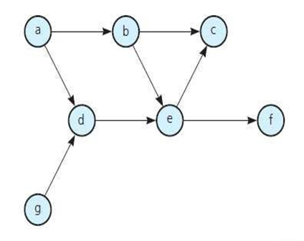
Number of edges - Directed Graph
The no. of possible pairs in an n vertex graph is n*(n-1).
Since edge (u, v) is not the same as edge (v, u), the number of edges in a directed graph is n*(n-1)
Thus, the number of edges in a directed graph is <= n*(n-1).

Slide 10
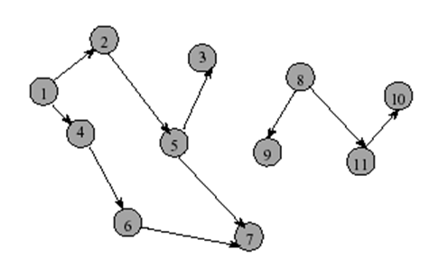
•In-degree of vertex i is the number of edges incident to i (i.e., the number of incoming edges).
e.g., in-degree(2) = 1, in-degree(8) = 0
•Out-degree of vertex i is the number of edges incident from i (i.e., the number of outgoing edges).
e.g., out-degree(2) = 1, out-degree(8) = 2

Slide 11
Representation of Graph:
Graph is a data structure that consists of following two components:
1. A finite set of vertices also called as nodes.
2. A finite set of ordered pair of the form (u, v) called as edge.
The pair is ordered because (u, v) is not same as (v, u) in case of a directed graph(di-graph). The pair of the form (u, v) indicates that there is an edge from vertex u to vertex v. The edges may contain weight/value/cost.

Slide 12
Adjacency Matrix:
●A square grid of boolean (1/0) values.
●If the graph contains N vertices, then the grid contains N rows and N columns.
●For two vertices numbered i and j, the element at row i and column j is true(1), if there is an edge from i to j, otherwise false(0).

Slide 13
Adjacency List:
●A graph of n nodes is represented by a one- dimensional array (L) of linked lists, where L[i] is the linked list containing all the nodes adjacent from node i. The nodes in the list L[i] are in no particular order.
->Adjacency list : for each vertex v ∈ V, store a list of vertices adjacent to v.
How much storage is required?
●The degree of a vertex v = # incident edges
●( Directed graphs have in-degree, out-degree )
For directed graphs, # of items in adjacency lists is Σ out-degree(v) = |E|
For undirected graphs, # items in adjacency lists is Σ degree(v) = 2* |E|
●So: Adjacency lists take O(V+E) storage

Slide 14
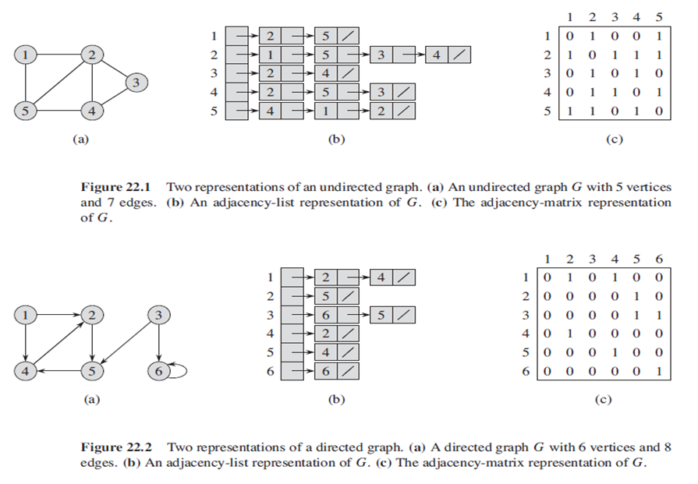

Slide 15
Graph Search Algorithm:
•Given a Graph G = (V, E) directed or undirected. The goal is to methodically explore every vertex and every edge.
There are two well known graph search algorithms :
Breadth First Search
Depth First Search

Slide 16
Breadth First Search:
•Breadth-first search (BFS) is an algorithm for traversing or searching tree or graph data structures. We need to know two important terminology to understand the process of BFS traversal.
Visiting a Vertex : This mean we are currently present on that vertex in the graph or tree.
Exploration of a Vertex : This refers to visiting all the adjacent vertices of the source vertex or the visiting vertex.

Slide 17
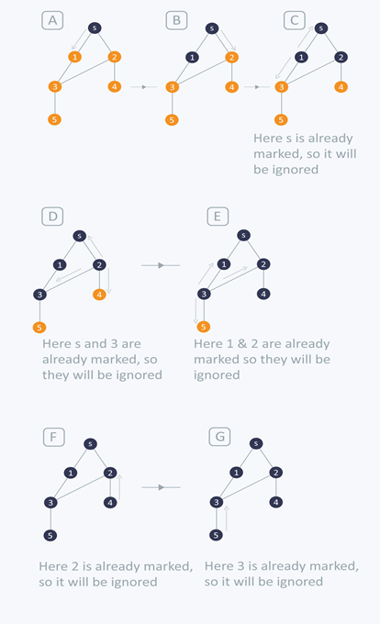
•BREADTH-FIRST TRAVERSAL (BFS) :
->The first step is to pick any vertex, that becomes are start vertex.
->Next step is to explore the current vertex we are on and explore
all the adjacent vertices to it.
->We repeat the above two steps until all the vertices of the graph
are visited at least once.
->We have explained the above steps using an
example. Note that the vertex marked with
dark colour are the visited or explored vertices.

Slide 18
•Like in previous example, in order to keep track of our BFS traversal we will use different colour i.e. white, grey and black, to denote vertices with different attributes.
Ø All vertices start out white. White represents un-visited or un-explored vertices.
Ø A vertex becomes non-white if it discovered the first time. We associate grey for such vertices. Grey represents the visited or first-discovered vertices.
ØA vertex becomes black if it is explored and we are required to begin the exploration of it’s adjacent visited vertices. Black represents the vertices that are explored.

Slide 19
Algorithm:
•The breadth-first search procedure assumes that the input graph
G = (V, E) is represented using adjacency lists.
•We store the colour of each vertex u ϵ V in the attribute u.color and the predecessor of u in the attribute in u.π.
•If u has no predecessor then u.π = NIL.
•The attribute u.d holds the distance from the source s to vertex u.
•The algorithm also uses first-in, first-out queue Q.

Slide 20
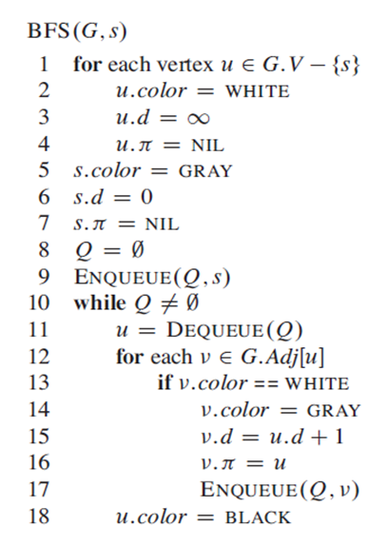
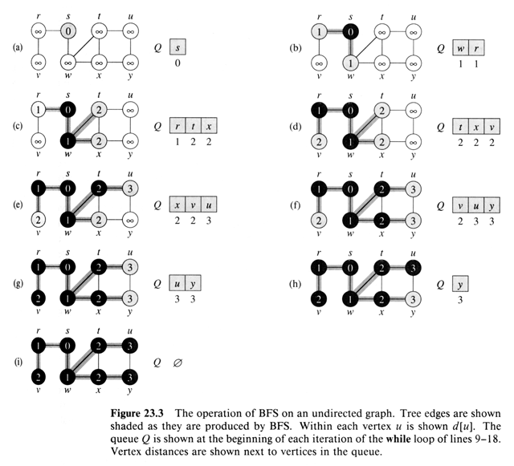

Slide 21
Depth First Search Algorithm:
•The strategy followed by depth-first search is, as its name implies, to search deeper in the graph whenever possible.
•DEPTH-FIRST SEARCH TRAVERSAL (DFS):
Ø Depth-first search explores edges out of the most recently discovered vertex v that still has un-explored edges leaving it.
Ø Once all of v’s edges have been explored, the search “backtracks” to explore edges leaving the vertex from which v was discovered.

Slide 22
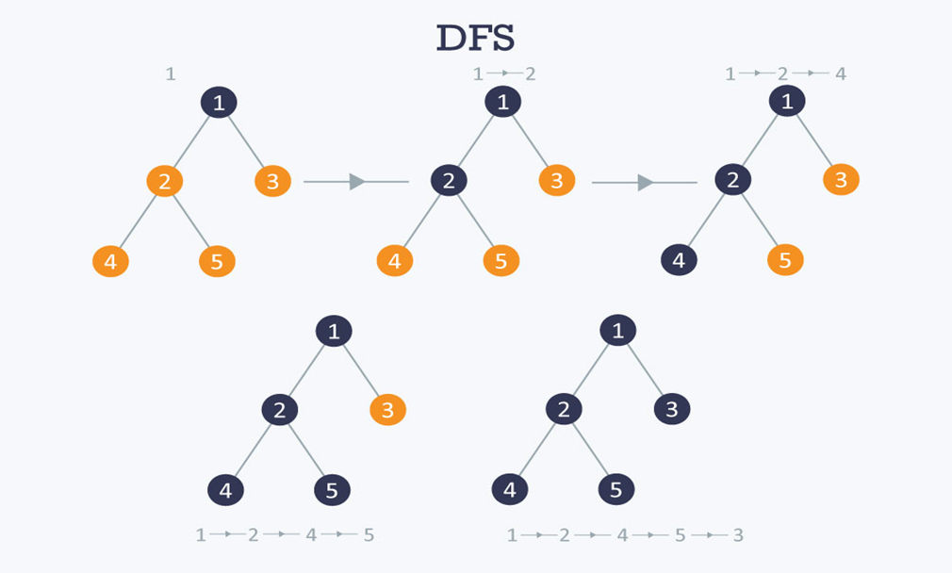

Slide 23
Algorithm:
•Whenever depth-first search discovers a vertex v during a scan of the adjacency list of an already discovered vertex u, it records this event by setting v’s predecessor attribute v.π to u.
•The predecessor subgraph of a depth-first search slightly differently from that of a breadth-first search :
G_{π} = (V, E_{π})
where , E_{π} = {(v.π, v) : v ϵ V and v.π ≠ NIL}

Slide 24
•Depth-first search also uses colours to mark the vertices with different attributes.
Ø Each vertex is initially white. White is used to represent the vertex which is un-visited and un-explored.
Ø When the vertex is discovered and visited it’s marked non-white. Grey represents the vertex that is discovered or visited.
Ø When all the adjacent vertices of the current discovered vertices are visited, the colour changes to black. Black is used to determine the exploration of vertex is completed or in other words, when the adjacency list of the vertex is completed.

Slide 25
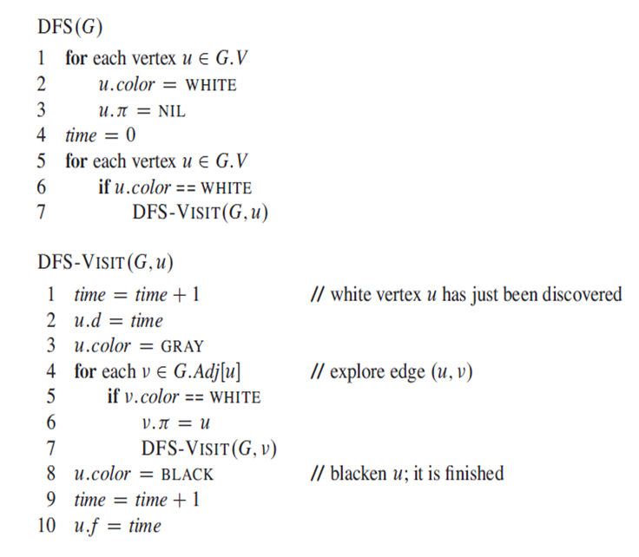

Slide 26
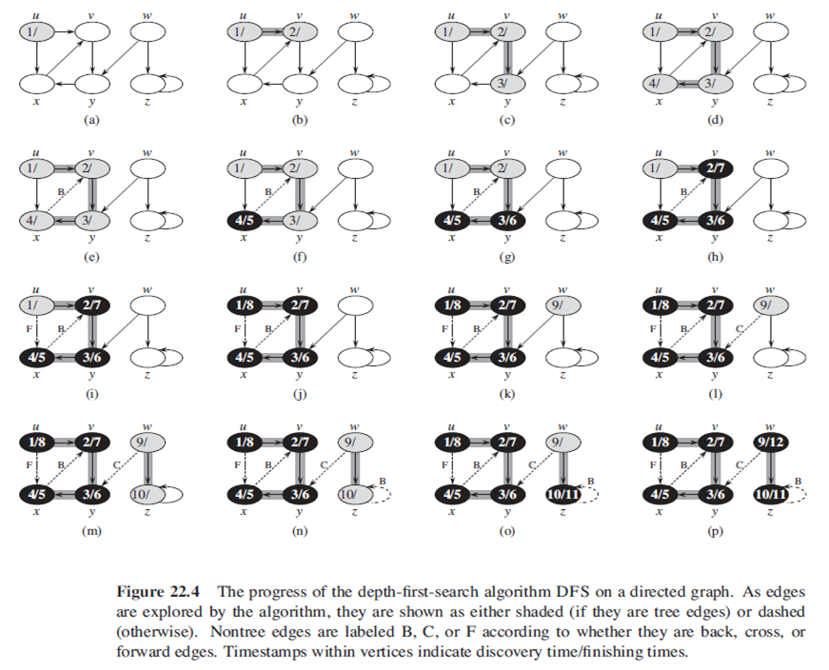

Slide 27
Spanning Tree:
ØA spanning tree T of an undirected graph G = (V, E) is a sub-graph of G, with the minimum possible number of edges.
ØA graph may have several spanning trees.
ØA graph that is not connected does not have any spanning tree.

Slide 28
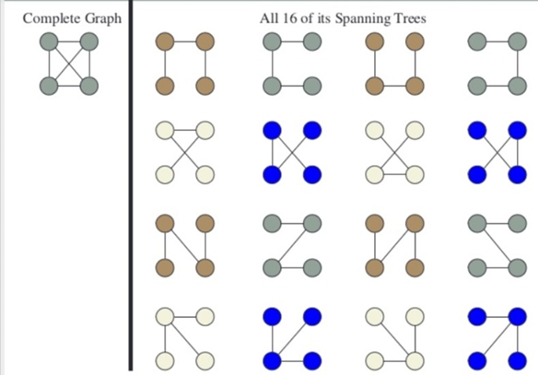

Slide 29
Minimum Spanning Tree:
ØA minimum spanning tree is a subset of the edges of a connected weighted undirected graph with the minimum possible total edge weights ( without any cycle ).
ØIt is a spanning tree whose sum of weights is as small as possible. A graph may have several minimum spanning trees
A minimum spanning tree has (V – 1) edges where V is the number of vertices in the given graph.
->There are mainly two methods used to find minimum spanning out of a connected weighted graph :-
Ø Prim’s algorithm
Ø Kruskal’s algorithm

Slide 30
•How many such spanning trees can be formed ?
Suppose |V| = 6 and |E| = |V|-1 = 5, where V, E ϵ vertices and edges respectively. Thus the possible combinations are :
N = ^{|V|}C_{|E|} = ⁶C₅
N = 6
NOTE : In case the total edges (in the graph) forms (m) cycles.
Then the possible combinations will be :
N = ^{|V|}C_{|E|} - m

Slide 31
Prim’s Algorithm:
•The idea is to maintain two sets of vertices. The first set contains the vertices already included in the MST, the other set contains the vertices not yet included.
•At every step, it considers all the edges that connect the two sets, and picks the minimum weight edge from these edges.
•After picking the edge, it moves the other endpoint of the edge to the set containing MST.

Slide 32
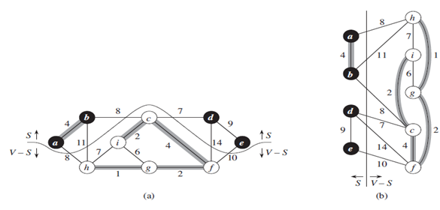
• A group of edges that connects two set of vertices in a graph is called cut in graph theory.
• At every step of Prim’s algorithm, we find a cut (of two sets, one contains the vertices already
included in MST and other contains rest of the vertices).
• Pick the minimum weight edge from the cut and include this vertex to MST Set.
(The set that contains already included vertices).

Slide 33
Algorithm:
–In order to implement Prim’s algorithm efficiently, we need a fast way to select a new edge to add to the tree formed by the edges in A.
–The connected graph G and the root r of the minimum spanning tree to be grown are inputs to the algorithm.
–During execution of the algorithm, all vertices that are not in the tree reside in a min-priority queue Q based on a key attribute.
–For each vertex v, the attribute v.key is the minimum weight of any edge connecting v to a vertex in the tree; by convention v.key = ∞ if there is no such edge.
–The attribute v.π names the parent of in the tree.

Slide 34
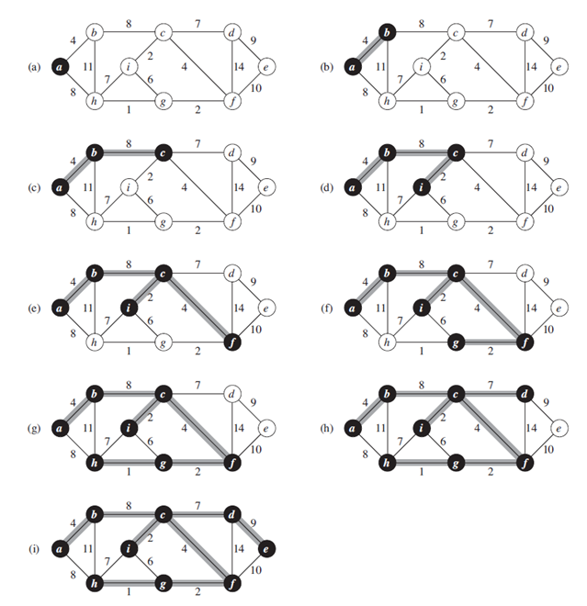
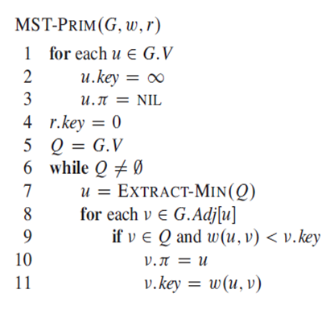

Slide 35
Kruskal’s Algorithm:
•Kruskal's algorithm is a minimum-spanning-tree algorithm which finds an edge of the least possible weight that connects any two trees in the forest. It is a greedy algorithm in graph theory as it finds a minimum spanning tree for a connected weighted graph adding increasing cost arcs at each step.
•Below are the steps for finding MST using Kruskal’s algorithm :
Ø Sort all the edges in non-decreasing order of their weight.
ØPick the smallest edge. Check if it forms a cycle with the spanning tree formed so far. If cycle is not formed, include this edge. Else, discard it.
Repeat step#2 until there are (V-1) edges in the spanning tree

Slide 36
Algorithm:
•It uses a disjoint-set data structure to maintain several disjoint sets of elements.
•The operation FIND-SET(u) returns a representative element from the set that contains u.
•We can determine whether two vertices u and v belong to the same tree by testing whether FIND-SET(u) equals FIND-SET(v).
•To combine trees, Kruskal’s algorithm calls the UNION procedure

Slide 37
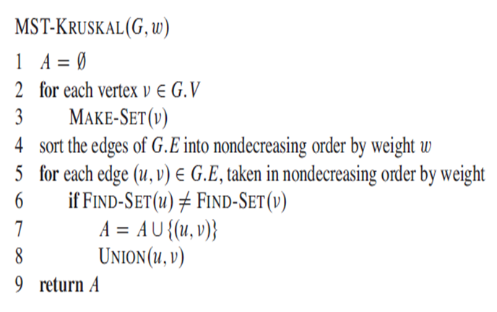

Slide 38
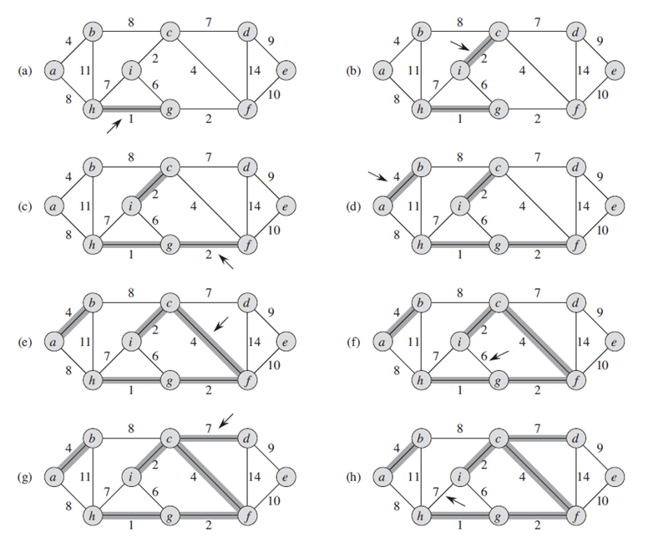

Slide 39
Single Source Shortest Path:
•In graph theory, the shortest path problem is the problem of finding a path between two vertices (or nodes) in a graph such that the sum of the weights of its constituent edges is minimized.
•In a shortest-paths problem, we are given a weighted, directed graph G(V, E), with weight function w : E à R, mapping edges to real-valued weights.
The weight w(p) of path p = {v₀, v₁, …, v_{k}} is the sum of the weights of its constituent edges:
w(p) = ∑^{k}_{i=1} w(v_{i-1,} v_{i})
We define the shortest path weight from u to v,
= min{w(p) : u ~> v}, if there is path from u to v
∞ , otherwise

Slide 40
Single Source Problems:
•The algorithm for the single-source problem can solve many other problems, including the following variants :
ØSingle Destination Shortest Path Problem : Find a shortest path from the given destination vertex t to the vertex v. By reversing the direction of each edge in the graph we can reduce each problem to single-source problem.
Ø Single Pair Shortest Path Problem : Find a shortest path from u to v for given vertices u and v. If we solve the single-source problem with source vertex u, we solve this problem also.
Ø All Pair Shortest Path Problem : Find a shortest path from u to v for every pair of vertices of u and v. Although we can solve this problem by running a single-source algorithm once from each vertex, we usually can solve it faster.

Slide 41
Dijkstra’s Algorithm:
•Dijkstra's algorithm (or Dijkstra's Shortest Path First algorithm, SPF algorithm) is an algorithm for finding the shortest paths between nodes in a graph, which may represent, for example, road networks.
•We generate a SPT (shortest path tree) with given source as root. We maintain two sets, one set contains vertices included in shortest path tree, other set includes vertices not yet included in shortest path tree.
•At every step of the algorithm, we find a vertex which is in the other set (set of not yet included) and has a minimum distance from the source.
Time Complexity for Dijkstra’s Algorithm is given by
O( |V|² )
Using min heap time complexity can be reduced to
O( |V|* log(|V| )

Slide 42
Algorithm:
•Dijkstra’s algorithm solves the single-source shortest-paths problem on a weighted, directed graph G(V, E) for the case in which all edge weights are nonnegative.
•Below are the detailed steps used in Dijkstra’s algorithm to find the shortest path from a single source vertex to all other vertices in the given graph.
Ø Dijkstra’s Algorithm maintains a set S of vertices whose final shortest path weights from the source s has already been determined.
Ø The algorithm repeatedly selects the vertex u ϵ V-S with minimum shortest path estimate, adds u to S, and relaxes all edges leaving u.
ØIn the following implementation, we use a min-priority queue Q of vertices, keyed by their d value.

Slide 43
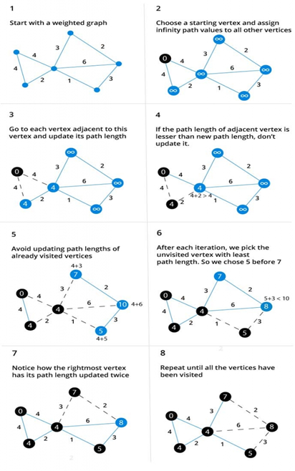
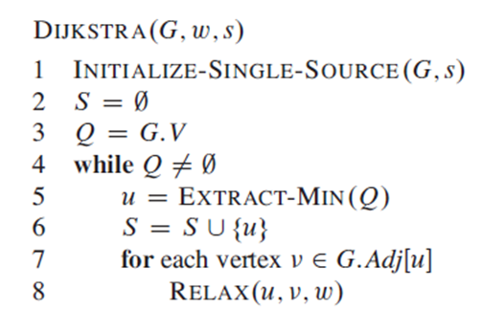

Slide 44
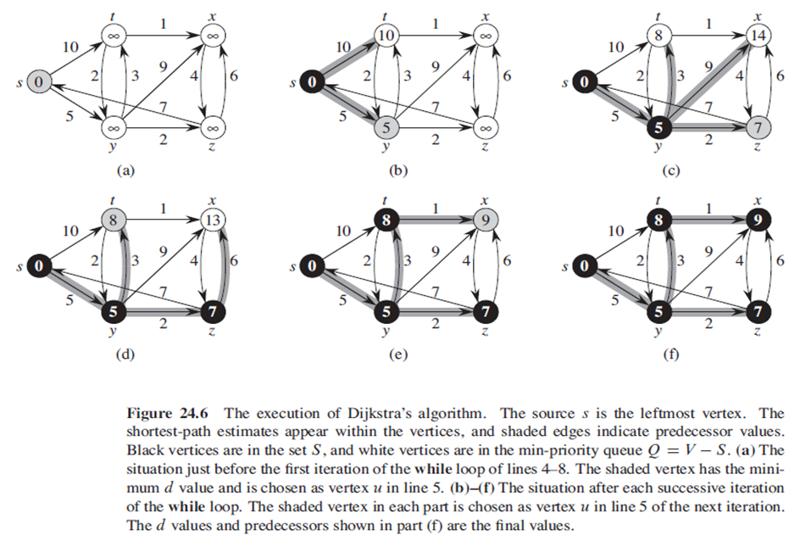

Slide 45
Bellman Ford Algorithm:
•The Bellman–Ford algorithm is an algorithm that computes shortest paths from a single source vertex to all of the other vertices in a weighted digraph.
•Negative edge weights are found in various applications of graphs, hence the usefulness of this algorithm.
•If a graph contains a "negative cycle" (i.e. a cycle whose edges sum to a negative value) that is reachable from the source, then there is no cheapest path: any path that has a point on the negative cycle can be made cheaper by one more walk around the negative cycle. In such a case, the Bellman–Ford algorithm can detect and report the negative cycle.

Slide 46
Why negative edges:
Negative weight edges might seem useless at first but they can explain a lot of phenomena like : -
ØCash flow
ØHeat released
ØHeat absorbed
For instance, if there are different ways to reach from one chemical A to another chemical B, each method will have sub-reactions involving both heat dissipation and absorption.
ØIf we want to find the set of reactions where minimum energy is required, then we will need to be able to factor in the heat absorption as negative weights and heat dissipation as positive weights.

Slide 47
Algorithm:
•Like Dijkstra's algorithm, Bellman–Ford proceeds by relaxation, in which approximations to the correct distance are replaced by better ones until they eventually reach the solution.
•In both algorithms, the approximate distance to each vertex is always an overestimate of the true distance, and is replaced by the minimum of its old value and the length of a newly found path.
•Dijkstra's algorithm uses a priority queue to greedily select the closest vertex that has not yet been processed, and performs this relaxation process on all of its outgoing edges; by contrast, the Bellman–Ford algorithm simply relaxes all the edges, and does this |V|-1 times, where |V| is the number of vertices in the graph.
•Bellman Ford runs in O(|V|*|E|) time, where |V| and |E| are the total number of vertices and edges respectively.

Slide 48
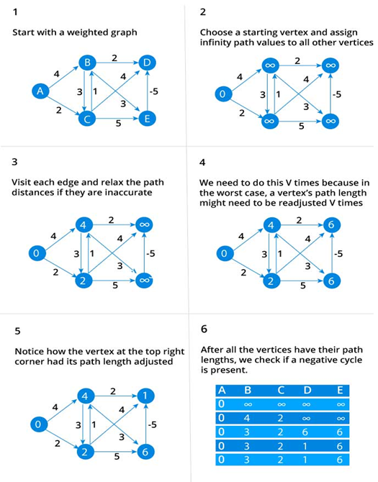
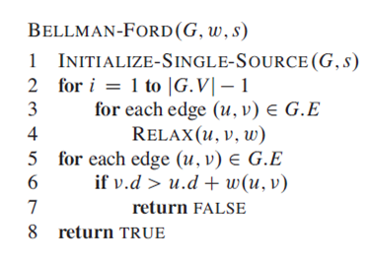

Slide 49
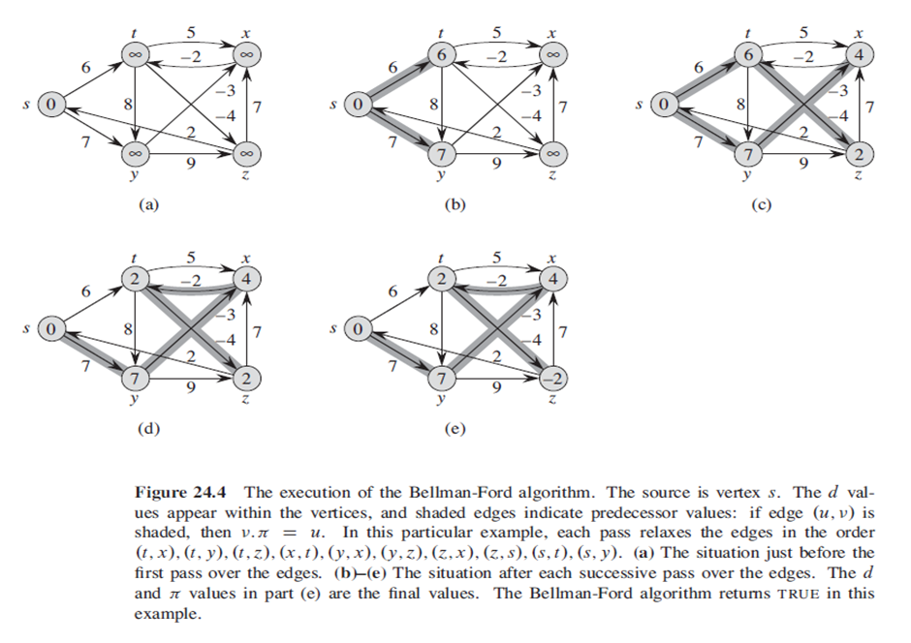

Slide 50
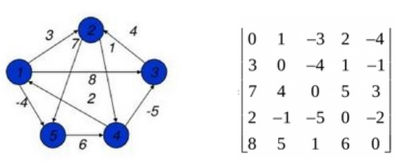
All Pair Shortest Path Algorithm:
•The all pair shortest path algorithm is also known as Floyd - Warshall algorithm is used to find all pair shortest path problem from a given weighted graph.
•As a result of this algorithm, it will generate a matrix, which will represent the minimum distance from any node to all other nodes in the graph.

Slide 51
Floyd Warshall Algorithm:
•We can solve an all-pairs shortest-paths problem by running a single-source shortest-paths algorithm |V| times, once for each vertex as the source.
•Unlike the single-source algorithms, which assume an adjacency-list representation of the graph, Floyd – Warshall algorithm uses an adjacency matrix representation.
•We assume that the vertices are numbered 1, 2, 3, …, |V| so that the input is an n × n matrix W representing the edge weights of an n-vertex directed graph G(V, E).
•The tabular output of the all-pairs shortest-paths algorithms is an n × n matrix D = (d_{ij}) where entry d_{ij} contains the weight of a shortest path from vertex i to vertex j .
Time Complexity for this algorithm
O(|n|³)
where n is the number of vertices in graph

Slide 52
Algorithm:
•To solve the all-pairs shortest-paths problem on an input adjacency matrix, we need to compute not only the shortest-path weights but also a predecessor matrix П = (π_{ij}) where π_{ij} = NIL, if i = j or there’s no path from i to j, otherwise π_{ij} is the predecessor of j on some shortest path from i.
•For each vertex, i ϵ V, we define the predecessor subgraph of G for i as G_{π, i} = (V_{π, i} , E_{π, i}), where
V_{π, i} = {j ϵ V : π_{ij} ≠ NIL} U {i}
And,
E_{π, I} = {(π_{ij} , j) : j ϵ V_{π, i} - {i}}

